Slide 1

Decompositions
By Tomer Sheffer & Roni Ben Dom

Slide 2
Matrix decomposition
In mathematics, factorization, or factoring is writing a number or another mathematical object as product of several factor usually of the same kind
Matrix decomposition, also named matrix factorization is writing a mztrix as a product of metrices

Slide 3

Cholesky decomposition
Cholesky decomposition is a decomposition of symetric, positive definite matrix into a product of a lower triangular matrix and its transpose
$$\left(\begin{matrix}a_{1, 1} & a_{1, 2} \\ a_{2,1} & a_{2, 2}\end{matrix}\right)=\left(\begin{matrix}l_{1,1} & 0 \\ l_{2,1} & l_{2,2}\end{matrix}\right) ×\left(\begin{matrix}l_{1,1} & l_{2, 1} \\ 0 & l_{2,2}\end{matrix}\right)$$

Slide 4

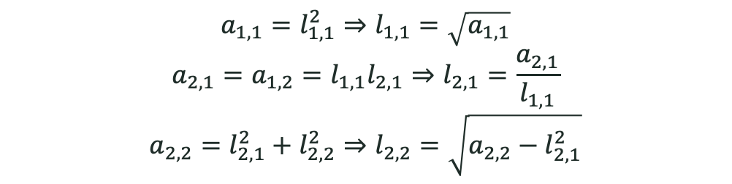
Cholesky decomposition – Algorithm example
$$\left(\begin{matrix}a_{1, 1} & a_{1, 2} \\ a_{2,1} & a_{2, 2}\end{matrix}\right)=\left(\begin{matrix}l_{1,1} & 0 \\ l_{2,1} & l_{2,2}\end{matrix}\right) ×\left(\begin{matrix}l_{1,1} & l_{2, 1} \\ 0 & l_{2,2}\end{matrix}\right)=\left(\begin{matrix}l_{1,1}^{2} & l_{2,1}l_{1,1} \\ l_{2,1}l_{1,1} & l_{2,1}^{2}+l_{2,2}^{2}\end{matrix}\right)$$
$$a_{1,1}=l_{1,1}^{2}⇒l_{1,1}=\sqrt{a_{1,1}}$$
$$a_{2,1}=a_{1,2}=l_{1,1}l_{2,1}⇒l_{2,1}=\frac{a_{2,1}}{l_{1,1}}$$
$$a_{2,2}=l_{2,1}^{2}+l_{2,2}^{2}⇒l_{2,2}=\sqrt{a_{2,2}−l_{2,1}^{2}}$$

Slide 5
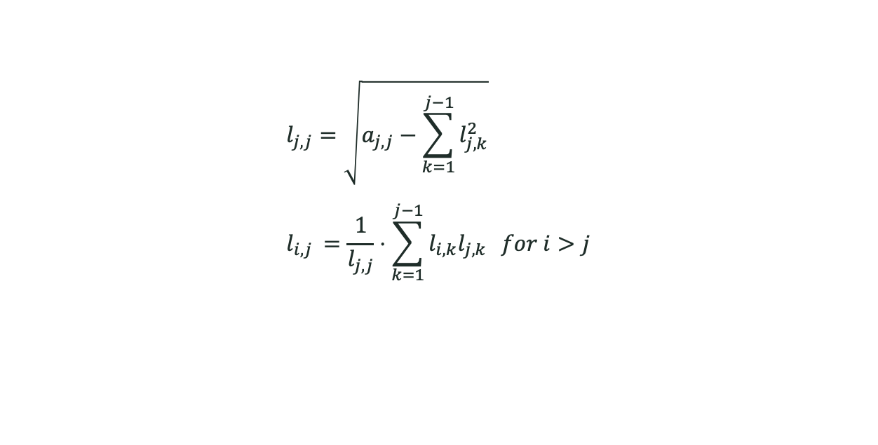
Cholesky decomposition – Algorithm
$$l_{j,j}=\sqrt{a_{j,j}−\sum_{k=1}^{j−1}{l_{j,k}^{2}}} \\ l_{i,j }=\frac{1}{l_{j,j}}⋅\sum_{k=1}^{j−1}{l_{i,k}l_{j,k}} for i>j$$

Slide 6
Cholesky decomposition - Usages
Cholesky decomposition has different usages, such as:
Monte-Carlo simulations
Kalman filters
Matrix inversion
We will focus on one very related to the course materia, a line search method called Quasi-Newton method.

Slide 7

Newton methods - recap
Recal that in Newton’s method we make the following update at each iteration:
$x_{k+1}=x_{k}−{H\left(x_{k}\right)}^{−1}∇f\left(x_{k}\right)$
In practice, each iteration involves solving the linear system:
$$H\left(x_{k}\right)⋅p_{k}=−∇f\left(x_{k}\right)$$
Where $p_{k}$ is the unknown - the Newton direction

Slide 8

Quasi-Newton methods
In Quasi-Newton methods, instead of computing the actual hessian, we approximate it, the approximation must satisfy the Quasi-Newton condition (Secant equation):
$$B_{k+1}⋅\left[x_{k+1}−x_{k}\right]= ∇f\left(x_{k+1}\right)−∇f\left(x_{k}\right)$$
Where $B_{k+1}$ is the approximation of the hessian in step k+1

Slide 9

Secant equation
We would like $B_{k}$ to approximate $∇^{2}f\left(x_{k}\right)$

Slide 10

Update the hessian approximation
There are numerous methods to update $B$, the hessian approximation:
BFGS
DFP
Symmetric rank-one update (SR1)
etc…
Where does Cholesky decomposition comes in handy?

Slide 11

Cholesky decomposition in Quasi-Newton methods
We require $B_{k}$ to be positive definite
Loss of the positive-definite condition through round-off error can be avoided if one updates the Cholesky decomposition of an approximation of the Hessian matrix itself rather than updating an approximation to the inverse of the Hessian

Slide 12
Cholesky decomposition in Quasi-Newton methods
Time complexity improvement

Slide 13

SVD – Singular Value Decomposition
A factorization of a real or complex matrix $M$ of the following form:
$$M=UΣV^{∗}$$
Where:
$U∈ℂ^{m×m} −$ Unitary matrix (orthogonal if $M$ is real)
$Σ∈ℂ^{m×n}−$Diagonal matrix with non-negative real numbers on the diagonal
$V∈ℂ^{n×n}−$Unitary matrix (orthogonal if $M$ is real)

Slide 14
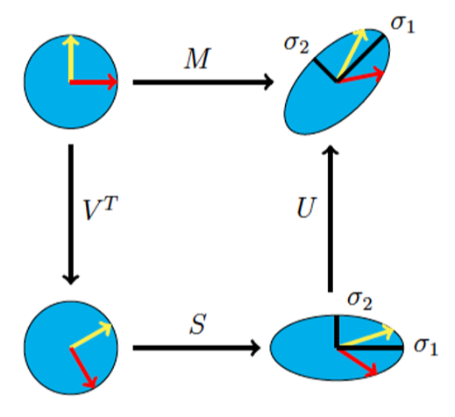





SVD
We will focus on real matrices:
$$M=UΣV^{T}∈ℝ^{m×n}$$
The geometric interpretation of SVD decomposition:
$$Rotation$$
$$Rotation$$
$$Σ$$
$$Scaling$$

Slide 15

SVD
Simple example:
$A=\left(\begin{matrix}4 & 4 \\ −3 & 3\end{matrix}\right)$
$AA^{T}$ is real and symmetric and therefore diagonalizable:
$$A^{T}A=VΛV^{T}=\frac{1}{\sqrt{2}}\left(\begin{matrix}1 & 1 \\ −1 & 1\end{matrix}\right)\left(\begin{matrix}32 & 0 \\ 0 & 18\end{matrix}\right)\frac{1}{\sqrt{2}}\left(\begin{matrix}1 & −1 \\ 1 & 1\end{matrix}\right)$$
Therefore:
$$Σ=\left(\begin{matrix}\sqrt{18} & 0 \\ 0 & \sqrt{32}\end{matrix}\right), U=AVΣ^{−1}=\left(\begin{matrix}0 & 1 \\ −1 & 0\end{matrix}\right)$$

Slide 16

SVD
Therefore the SVD decomposition is:
$$A=UΣV^{T}=\left(\begin{matrix}0 & 1 \\ −1 & 0\end{matrix}\right)\left(\begin{matrix}\sqrt{18} & 0 \\ 0 & \sqrt{32}\end{matrix}\right)\left(\begin{matrix}\frac{1}{\sqrt{2}} & \frac{1}{\sqrt{2}} \\ −\frac{1}{\sqrt{2}} & \frac{1}{\sqrt{2}}\end{matrix}\right)$$

Slide 17

PCA for Dimensionality reduction
PCA – Principal component analysis
Assume we have a dataset matrix $X=\left(\begin{matrix}x_{1,1} & ⋯ & x_{1,n} \\ ⋮ & ⋱ & ⋮ \\ x_{m,1} & ⋯ & x_{m,n} \end{matrix}\right)∈ℝ^{m×n}$
$m$ instances of $n−$dimensional feature vectors
Our data might include features that contain major amount of information (the principal components), while the others contain only minor amount of information
SVD helps us to identify the principal components of our data

Slide 18

PCA for Dimensionality reduction
We perform SVD on the covariance matrix of our dataset:
$$Σ=\frac{1}{m}X^{T}X$$
The implication is finding the principle eigenvalues of $Σ$, which correlate to the variance of each feature
Features with higher variance carry more information on the data
We drop features with low eigenvalue\variance to reduce computation and storage efforts

Slide 19

Dimensionality reduction in PCA
Example $\#1$
2D dataset
Example $\#2$
PCA on images

